Slide 1


Forecasting Air Quality Using Historical Pollution Data
An AI-powered initiative to predict air quality index (AQI) and pollutant levels, empowering authorities, city planners, and communities to take preventive action for healthier environments and informed decision-making.
Intern: K Pravalika Reddy
Start Date: September 22, 2025
Mentor: Umme Asma Mam
Tools: Python, Streamlit
Batch: 03
Repository: GitHub

Slide 2

AirAware: Smart Air Quality Prediction System
An advanced platform leveraging machine learning for real-time air pollution forecasting to empower smart cities and healthier environments.
Real-Time Forecasting
Advanced ML models predict pollutant levels with exceptional accuracy
Interactive Dashboards
User-friendly visualizations for data-driven environmental decisions
Health Alerts
Proactive notifications protect vulnerable populations from hazardous conditions

Slide 3
Technology Stack Driving AirAware
Comprehensive tools enabling robust development, data processing, machine learning, and visualization for accurate air quality predictions.
Programming & Version Control
Python 3 on Google Colab for agile development
GitHub for collaborative version control
Data Processing & Acquisition
Pandas and Numpy for efficient data manipulation
Machine Learning & Visualization
Classical models with scikit- learn and XGBoost
Time series analysis via Prophet
Static plotting with matplotlib and seaborn
Interactive dashboards with HTML, CSS, JavaScript, and Streamlit

Slide 4
Decoding the Air Quality Index (AQI)
Understanding AQI categories helps communities recognize health risks and take appropriate protective measures based on current pollution levels.
AQI Category Range |  | Color Health Implications
Good | 0 – 50 | Green | Satisfactory air quality with little or no risk
Moderate | 51 – 100 | Yellow | Acceptable quality; minor risk for sensitive groups
Unhealthy for Sensitive | 101 – 150 | Orange | Increased risk for children, elderly, and respiratory conditions
Unhealthy | 151 – 200 | Red | Health effects in general population; sensitive groups more affected
Very Unhealthy | 201 – 300 | Purple | Health warnings; increased risk of serious effects
Hazardous 301 - 500 |  | Maroon Emergency conditions; entire population likely affected

Slide 5
Major Air Pollutants Impacting Health and Environment
AirAware tracks eight key pollutants to enable targeted interventions, protect public well-being, and inform policy decisions with precision.
Particulate Matter (PM10 & PM2.5)
Fine particles from vehicles, construction, and dust penetrate deep into the lungs, causing respiratory and cardiovascular issues.
Carbon Monoxide (CO)
Toxic, odourless gas from incomplete combustion in vehicles and industrial processes, reducing oxygen delivery in the blood.
Nitrogen Dioxide (NO¢)
Causes airway irritation and inflammation, mainly from traffic emissions and power generation.
Sulfur Dioxide (SO¢)
Contributes to acid rain and respiratory problems, originating from fossil fuel burning in industry and power plants.
Ozone (O£)
Ground-level ozone affects breathing capacity and respiratory health, formed by chemical reactions in sunlight.
Ammonia (NH£)
Irritates the eyes and respiratory tract, commonly released from agricultural activities and fertiliser use.
Lead (Pb) & Benzene
Neurotoxic heavy metals and carcinogenic VOCs from fuels and industry affect the nervous system and long-term health.

Slide 6


Empowering Air Quality Management Through Agencies and Apps
Government bodies and mobile platforms deliver real-time data, forecasts, and personalised alerts to monitor air quality across cities globally.
Government Agencies Monitoring Air Quality
India's SAFAR and CPCB overseeing air quality in over 300 cities with comprehensive monitoring networks
USA's AirNow providing national air quality information and public alerts
Collaborative frameworks enhancing environmental governance and cross-border data sharing
Mobile Apps Delivering Real-Time Data
AirVisual offering real-time pollution data, forecasts, and historical trends
Plume Labs providing location-based air quality alerts and personalized recommendations
BreezoMeter delivering health advisories tailored to individual sensitivity levels Official national apps empowering citizens with localized, actionable updates

Slide 7

Key Sources Driving Air Pollution in India
Biomass burning dominates pollution sources with 55% share, intensifying Delhi's air quality crisis during the October-November stubble burning season.
Biomass Burning Industrial s Power Vehicular Emissions Episodic Sources
Agricultural residue burning, concentrated in post-harvest months, creates hazardous air quality episodes affecting millions. Industrial operations and power generation contribute significantly year-round, while vehicular emissions add to urban pollution baselines.

Slide 8
Critical Health and Environmental Threats of Air Pollution
Understanding multi-system health risks and ecosystem damage is essential to prioritize urgent mitigation efforts and protect vulnerable populations.
Respiratory & Cardiovascular Disease
Air pollution triggers asthma, chronic obstructive pulmonary disease (COPD), heart attacks, and strokes4reducing life expectancy and quality of life across all age groups.
Neurological Impacts
Increased risk of cognitive decline, dementia, and neurodevelopmental disorders, particularly affecting children's learning and elderly mental health.
Prenatal & Developmental Effects
Exposure during pregnancy leads to low birth weight, premature births, and developmental complications affecting long-term child health outcomes.
Environmental Degradation
Accelerates climate change, causes acid rain, degrades soil and water quality, and contributes to biodiversity loss4 threatening ecosystem stability.
Vulnerable Populations
Children, elderly, pregnant women, and individuals with pre-existing conditions face disproportionately higher risks requiring targeted protective interventions.

Slide 9



Effective Solutions to Combat Air Pollution
Integrated strategies across personal, industrial, and urban scales create comprehensive pathways to improved air quality and sustainable environmental health.
Indoor Air Quality
Deploy air purifiers with HEPA filters and UV sterilization to remove particulates and pathogens. Improve ventilation systems and monitor indoor pollution levels continuously.
Personal Protection
Use N95 or higher-grade masks during high pollution episodes. Reduce vehicle trips by choosing public transport, carpooling, or active commuting alternatives.
Clean Energy Transition
Adopt solar power and wind energy for residential and commercial use. Transition to electric vehicles to eliminate tailpipe emissions at the source.
Industrial Emission Control
Install scrubbers, electrostatic precipitators, and catalytic converters to capture pollutants before release. Implement continuous emission monitoring systems.
Agricultural Innovation
Deploy bio-decomposers to manage crop residue sustainably, eliminating the need for stubble burning and reducing seasonal pollution spikes

Slide 10

End-to-End Prediction Pipeline
A comprehensive workflow transforming raw sensor data into actionable air quality insights through advanced analytics and deployment.
Input
Raw air quality sensor data collected from monitoring stations (CSV format)
Processing
Data cleaning, feature engineering, and normalization for model readiness
Modeling
ARIMA, Prophet, LSTM, and XGBoost trained on historical patterns
Evaluation
MAE, RMSE, and R² score comparison to select the optimal model
Deployment
Interactive web dashboards with real-time forecasts and visualisations
Output
AQI predictions, automated health alerts, and policy-ready insights

Slide 11
Driving Impact Through Structured Project Milestones
A clear four-stage pipeline delivering scalable, user-focused air quality insights that transform raw data into actionable environmental intelligence.
01 02
Data Preparation
Perform comprehensive data cleaning and exploratory analysis to convert raw sensor data into reliable, structured inputs. This includes handling missing values, removing duplicates, and ensuring data quality standards.
Time Series Forecasting
Develop and train multiple machine learning models using an 80-20 data split for accurate air quality predictions. Models include ARIMA for statistical patterns, Prophet for seasonal trends, LSTM for sequential dependencies, and XGBoost for ensemble learning.
03
04
Static Alert Dashboard
Deliver a production-ready HTML dashboard featuring real-time Air Quality Index (AQI) gauges, color-coded health warnings, and forecast visualization accessible to stakeholders without technical expertise.
Interactive Streamlit Dashboard
Deploy a locally hosted, interactive web application with multi- pollutant monitoring, dynamic forecasting capabilities, customizable date ranges, and administrator controls for model retraining and system management.

Slide 12

AirAware's Key Differentiators
What sets this project apart from typical air quality prediction implementations and academic research initiatives?
1 Multi-Model Ensemble Approach
Unlike typical single-model projects, AirAware trains and compares four different ML architectures (ARIMA, Prophet, LSTM, XGBoost) and automatically selects the best performer, ensuring robustness across diverse pollution patterns.
2
Production-Ready Implementation
Fully deployed with dual-tier dashboards (HTML + Streamlit), model versioning, admin controls, and real-time retraining capability4not just Jupyter notebooks, but a complete solution ready for operational use.
91.3%
Data Quality Improvement
Transformed 9,471×1 malformed rows into 827×14 clean columns, removed 4,529 duplicates, achieving 100% completeness
4
ML Models Compared
ARIMA, Prophet, LSTM, and XGBoost were trained and evaluated for optimal performance. LSTM is best for my data.
100%
Open Documentation
Complete GitHub repository with reproducible code, datasets, and step-by-step instructions

Slide 13
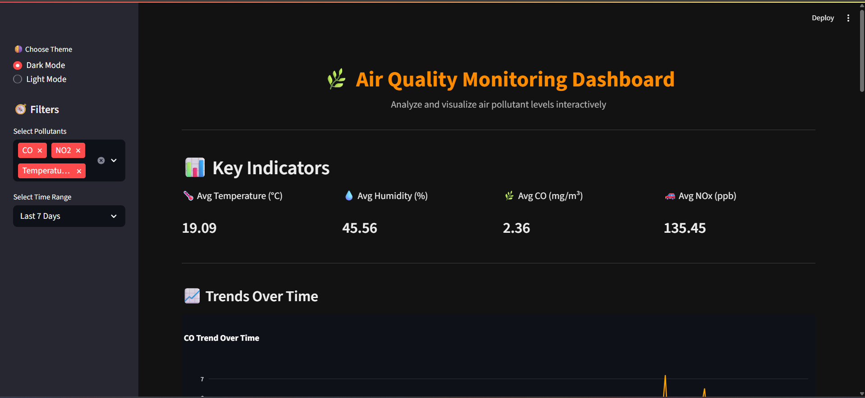
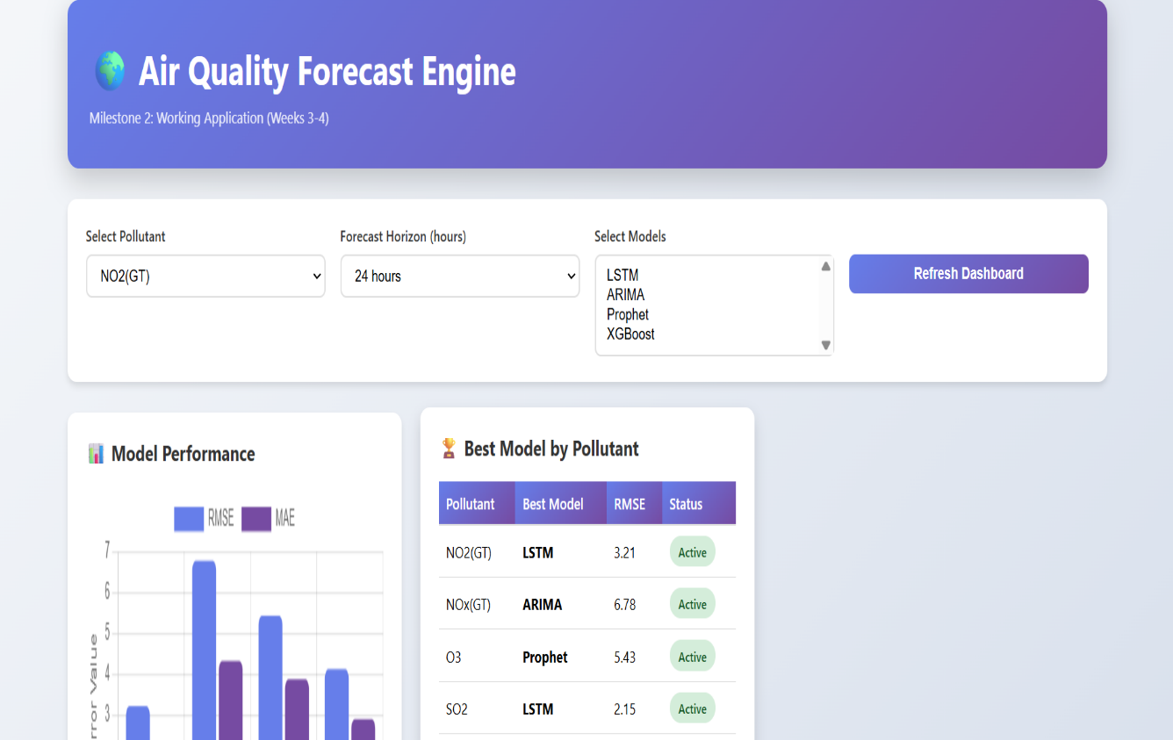
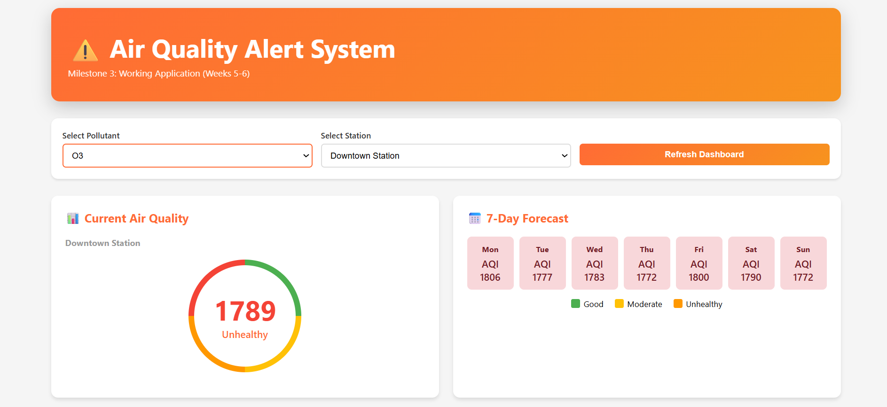
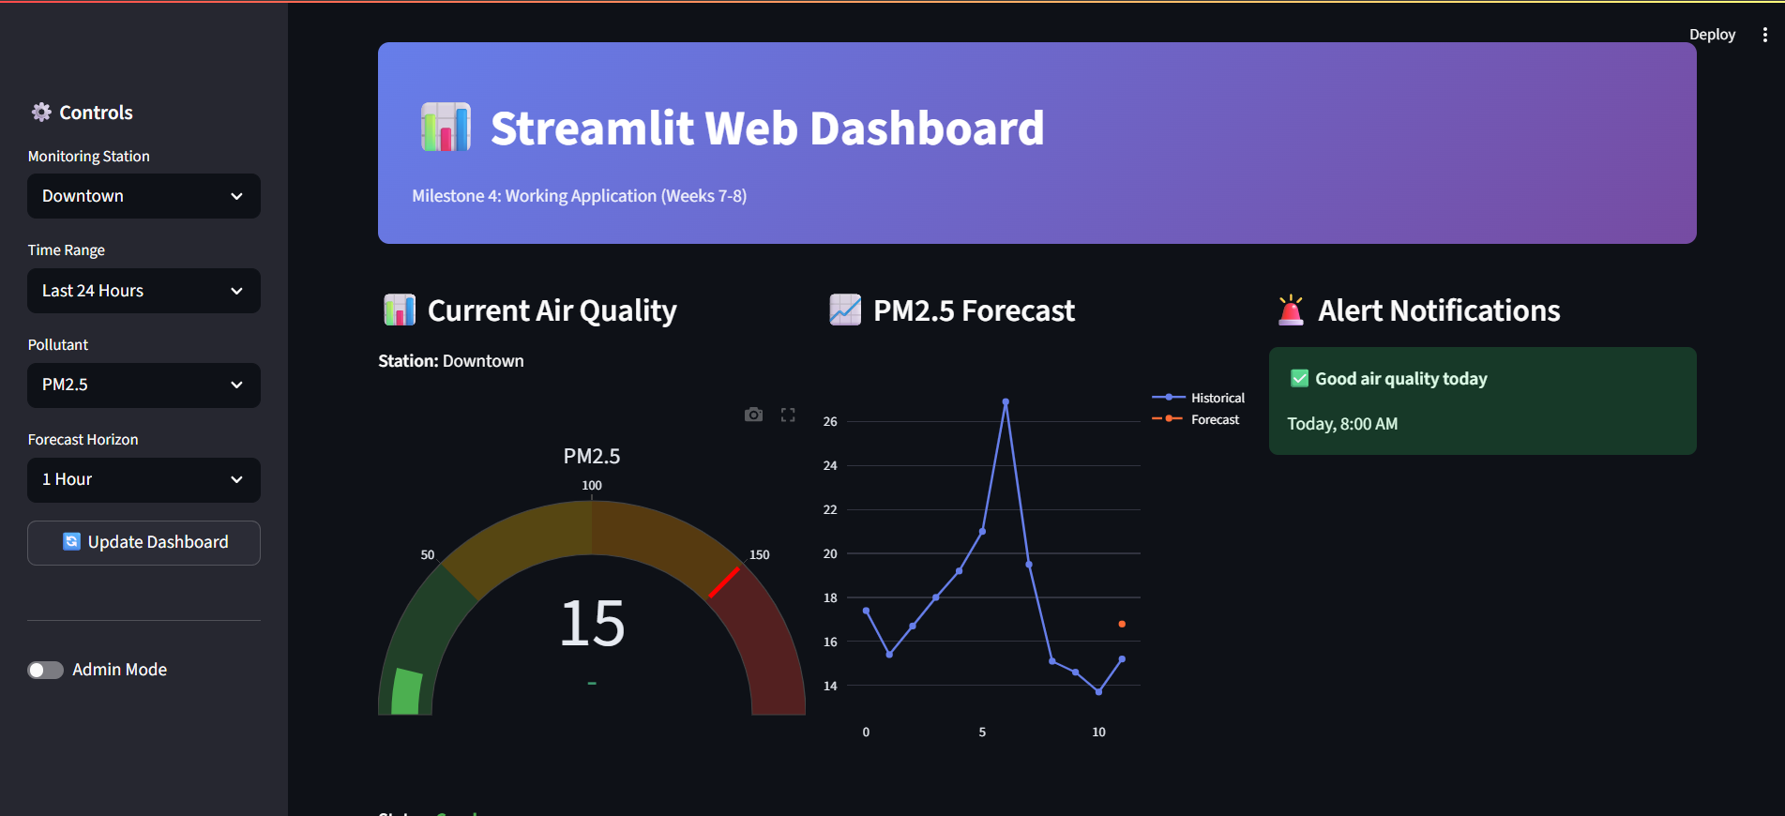

Slide 14


Explore the Code
Access the complete open-source repository with datasets, model implementations, dashboard code, and comprehensive documentation.
View on GitHub
Complete Documentation
Step-by-step setup instructions and architecture overview
Reproducible Code
Well-structured Python scripts for all pipeline stages
Cleaned Datasets
Production-ready data files included for immediate use

Slide 15

Thank You
Kondam Pravalika Reddy
Batch 03

